Slide 1
Requirements and Project Scope

Slide 2

Project Proposal
Who is the client
Corporation
Non –Profit
Individual
What is the software to be developed
Does it meet the minimum requirements?
Login with credentials
Database backend
User Interface (UI)
Other project types
A.I. Technology
Embedded Systems
Is the project possible?
Remember the project has to be delivered at the end of the semester
Is the technology available
Is the project legal

Slide 3
Project Charter
Description of need
What is the need for the software
Is the software need legitimate
Assumptions and constraints
The project must end at the end of CSC 191
The client must be aware of this

Slide 4
Project Charter
Support
After CSC 191 there will be no support
Ownership
Ownership of the code will be held by the client and the dev team
Unless explicitly stated
CSUS reserves the right to use developed documentation and products as examples of student work
The client will sign the Product Charter it is up to the team to make sure they are aware of what they are signing (Due Diligence)

Slide 5
Project Charter
Review Assignment Draft of Project Charter Template (Course Canvas)
Only a draft of the Charter
I will review the summited draft and provide feedback
The client & Development team will sign the finalized Project charter, this is a separate assignment.

Slide 6
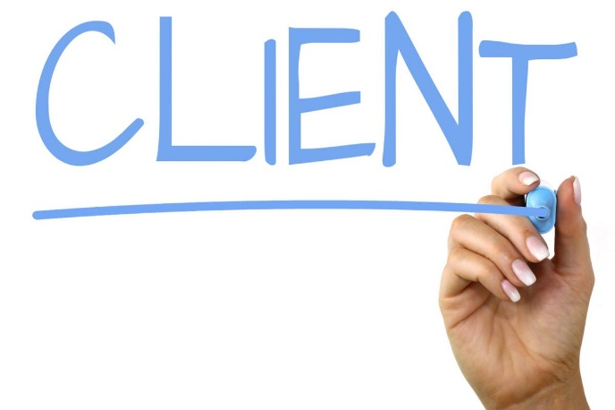
Know Your Clients Business Domain
Who is the customer?
What is the product?
How is the product sold? (online, phone, in-person sales)
What is the cost structure of the product? (subscription, pay-per-unit, etc)
Where does the money go?
How do we fulfill or distribute the product?
How do we produce or service the product?
How do we support the customer?
How do we market the product?
What partners do we work with to do business? How do we manage these relationships?
What information does the organization manage? Who is responsible for creating, updating, and retiring information?
What systems are used to manage the information.

Slide 7
Clients Your Stakeholders
Set the agenda and keep to it
Limit the duration of the interview to the time stated in the agenda. (<90mins)
Have business use cases serve as an anchor for the interview
Ask a question, listen to the answer, and then feed back your understanding
Draw models and encourage the user to change them
Use the stakeholders’ terminology and artifacts, both conceptual and real
Keep samples or copies of artifacts and log them for future reference
Thank the stakeholders for their time and tell them what you learned and why it was valuable
Write down what you were told – Send you notes back to the client for review!!!
They will often correct or clarify things you may not have understood
With reflection, they will often thing of things that were missed.

Slide 8

Project Requirements
Platform
Web
Browsers (Chrome, Brave, Firefox, Edge)
Phone or Desktop Browsers
Desktop
Mac
Linux
Windows
Unknown?
Phone/tablet
Apple or Android
Both?
Embedded
Can you obtain access
Special instruction set (compiler supported?)

Slide 9
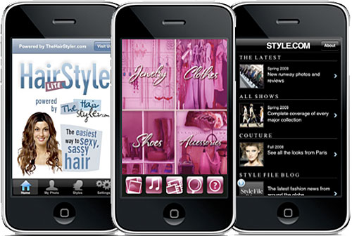
Project Requirements
Styling
Look and feel of the application
Provide prototype art
Detailed design of each view
Popup and error handling
Site/App flow

Slide 10
Project Requirements
Database
SQL
Detailed ERD
Plan for speed
What is being saved to the database
Encryption?
How long is the data stored?
PII ?
NOSQL
Research how to traverse
What is being stored?
Encryption?
No Database

Slide 11


Project Requirements
Servers
AWS
Costs to client
AZURE
Costs to client
Google Cloud
Costs to client
Works for your use case?
AWS Source: https://calculator.aws/#/
Google Cloud Source: https://cloud.google.com/products/calculator
Google Cloud Source: https://azure.microsoft.com/en-us/pricing/calculator/

Slide 12

Project Requirements
Login
Password requirements
Hashing Requirements
API’s
What APIs are needed?
Costs of API’s
Google Maps API Pricing Source: https://mapsplatform.google.com/pricing/

Slide 13

Project Requirements
Legality
API use
Developer Licenses
Open Source
Storage requirements (PII)

Slide 14
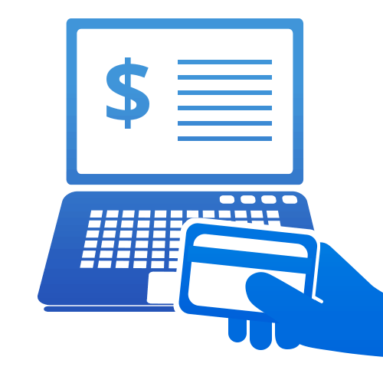
Project Requirements
Payment Methods
Visa/Mastercard
Service Fees
PayPal
Venmo
Crypto
FEES
PayPal API Source: https://developer.paypal.com/api/rest/

Slide 15

Project Requirements
Costs
App Store
Server
Payment fees
API Fees
Software Licensing Fees

Slide 16

Questions?
Next Lecture
In class Assignment
Minimum Viable Product

Slide 17
References
https://www.bridging-the-gap.com/reverse-engineering-requirements-how-to-explore-the-system/
https://www.bridging-the-gap.com/new-business-domain/
https://www.bridging-the-gap.com/what-questions-do-i-ask-during-requirements-elicitation/
https://www.bridging-the-gap.com/10-ways-to-discover-what-the-problem-really-is/

